Slide 13
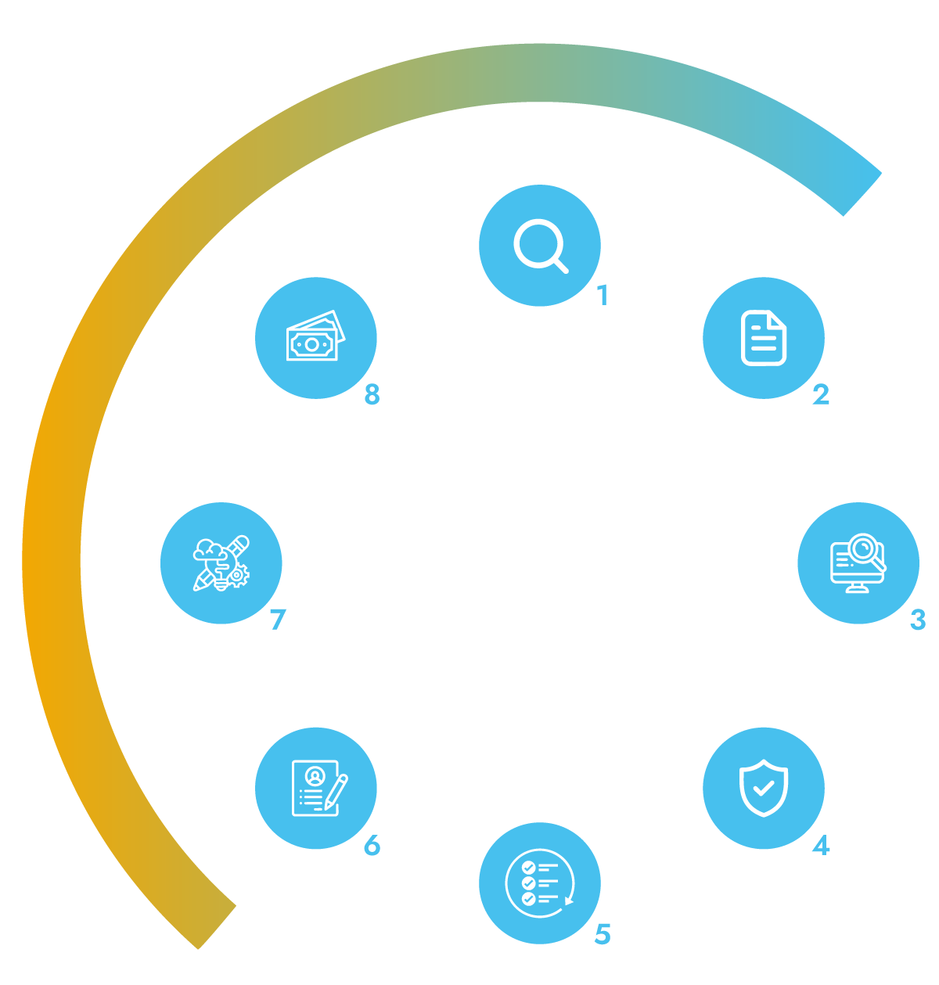
Your partner for
IP lifecycle
management

